Slide 1
Jatim Camp#4
Workshop Business Analytic Intelligence And Machine Learning With Rstudio
26 – 27 April 2019, At Hotel Cleo Surabaya

Slide 2


Profile
Amri Muhaimin
Pendidikan S1 Statistika Institiute Teknologi Sepuluh Nopember
Organisasi Professional Statistics (Statistika ITS) 2016-2017
Digitalent Scholarship Batch 1 by Kominfo
Staff Internal DSI Jatim 2019
A Wildan Al Azis
Pendidikan S1 Statistika Institiute Teknologi Sepuluh Nopember
Staff Internal DSI Jatim 2019
Data Analyst At Fineoz Jakarta

Slide 3
Outline
Day 1
Preview BI
Getting, Collecting Data
Cleaning and Preparing Data
Visualize Data
Machine Learning
Day 2
Deep Down Machine Learning
Feature Selection
Oversampling
Model Comparison

Slide 4
Set up and develop project space
Acquire Data
Wrangle Data
Perform Analytics
Develop report/data product
Document the process

Slide 5
Sebelum Dimulai
library(twitteR)
library(dplyr)
library(zoo)
library(ggplot2)
library(reshape)
library(VIM)
library(Hmisc)
library(mice)
library(datasets)
library(gganimate)
library(gganimate)
library(gapminder)
library(tidyr)
library(graphics)
library(RCurl)
library(cowplot)
library(forecast)
library(caret)
library(DMwR)
library(MASS)
library(caTools)

Slide 6





Internet
Crawling
Scraping
Beberapa Contoh Format Data
read.csv
fromJson
read.table
Local Disk

Slide 7
Melihat Directory
getwd()
"C:/Users/user/Documents"

Slide 8
Mengimpor Data Ke R#1
#download
download.file("http://archive.ics.uci.edu/ml/machine-learning-databases/00235/household_power_consumption.zip",
destfile = "C:/Users/user/Documents/household_power_consumption.zip")
#unzip
unzip("C:/Users/user/Documents/household_power_consumption.zip")
#read to R
power = read.table("C:/Users/user/Documents/household_power_consumption.txt", sep=";", header=T, na.strings=c("?",""), stringsAsFactors=FALSE)
Melakukan download dari internet, melakukan unzip (jika data dalam format rar). Terakhir mengimport data tersebut ke dalam R.

Slide 9
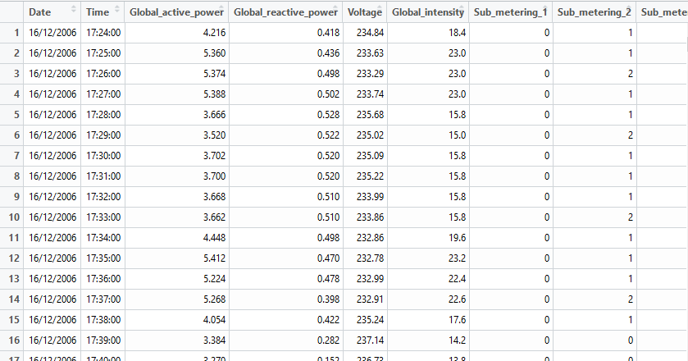
Mengimpor Data Ke R#1
View(power)

Slide 10
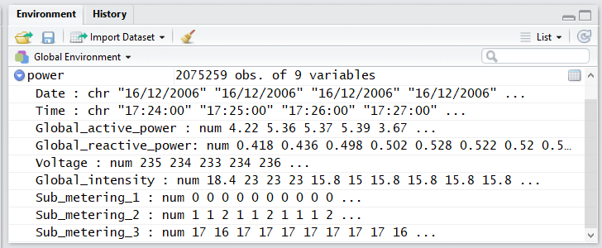

Slide 11
Mengimpor Data Ke R#2
Jika data sudah berada dalam local disk dan sesuai format yang dapat dibaca oleh R, mengimport data ke dalam R tidak begitu rumit. Tapi ingat, perhatikan separator dalam format data tersebut.

Slide 12

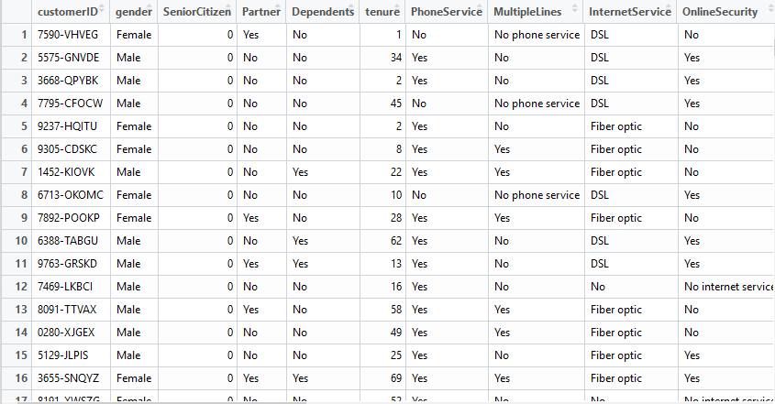
Mengimpor Data Ke R#2

Slide 13

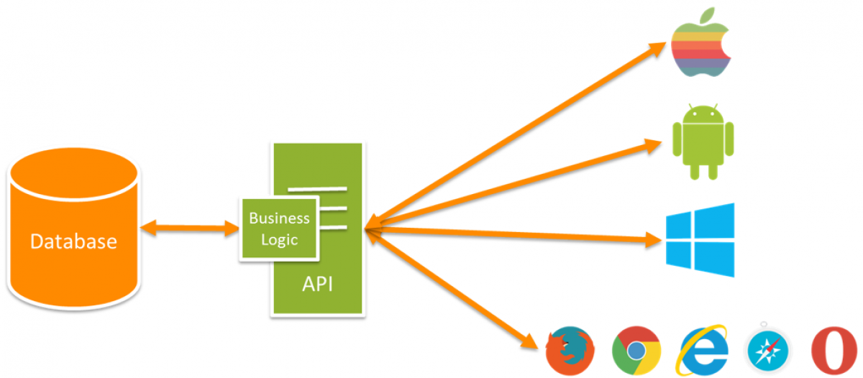


Crawling Data From Internet
Crawling adalah aplikasi script program untuk melakukan scan kesemua halaman di internet dan dibuatkan index untuk data yang dicarinya
Skema crawling

Slide 14
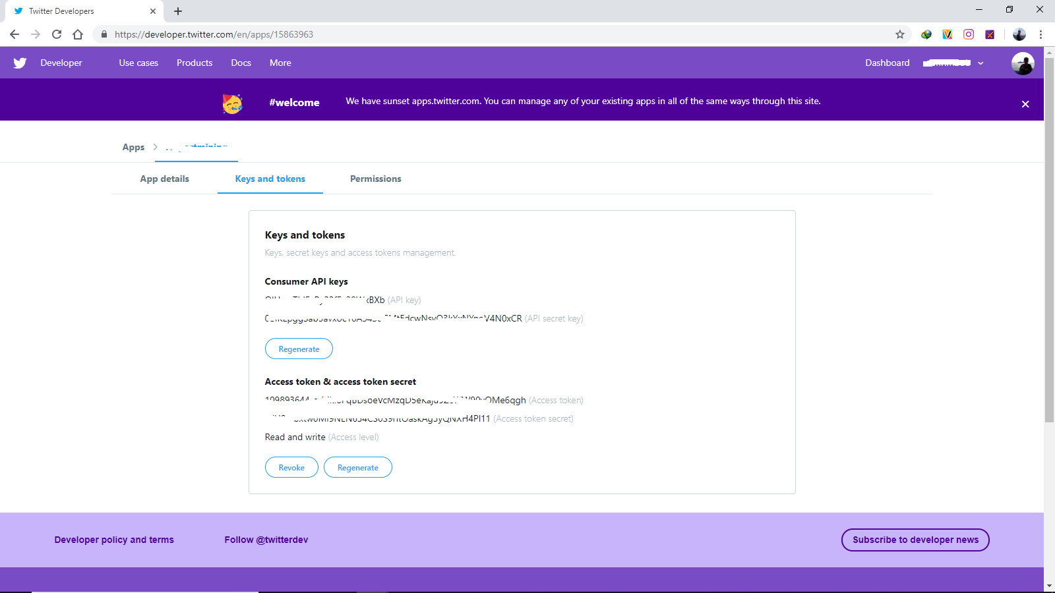
Contoh Mengambil Tweet dari Twitter

Slide 15
Collect Tweet From Twitter
#Definisikan API
consumer_key = 'OlHsruThlEzRyXXXXXXX'
consumer_secret = '0BlKLpggSab5avxoc16A5XXXXXXXXXXXXXXXXXXXXXXXX'
access_token = ‘XXXXXXXX-erMkl8PqBDsoeVcMzqD5eKaju9ZcWW90vOMe6qgh'
access_secret = ‘XXXXXXXXXXXXXXEN634CS0S9rItOaskAg3yQNXH4Pl11'
#Menseetup
setup_twitter_oauth(consumer_key, consumer_secret, access_token, access_secret)
#Mulai Mencari Tweet
tweets = searchTwitter("#AvengersEndgame", n = 1000, lang = "en")
#merubah tweet kedalam bentuk data frame
tweets = twListToDF(tweets)

Slide 16
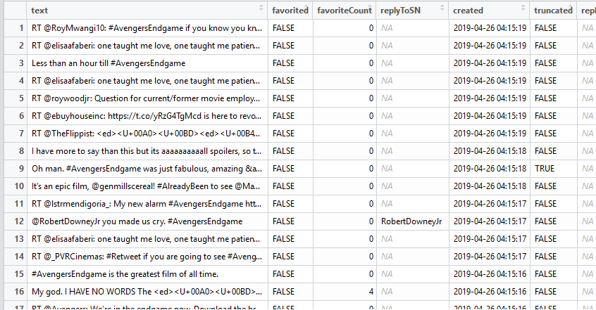
View(tweets)

Slide 17

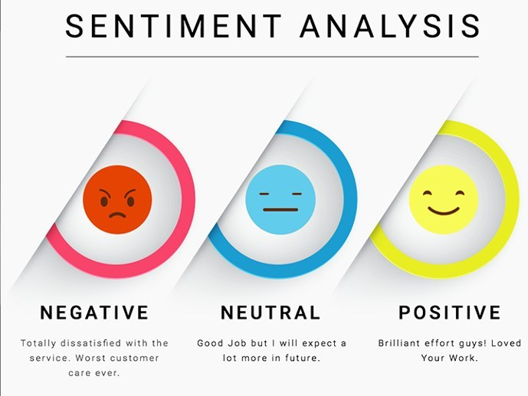
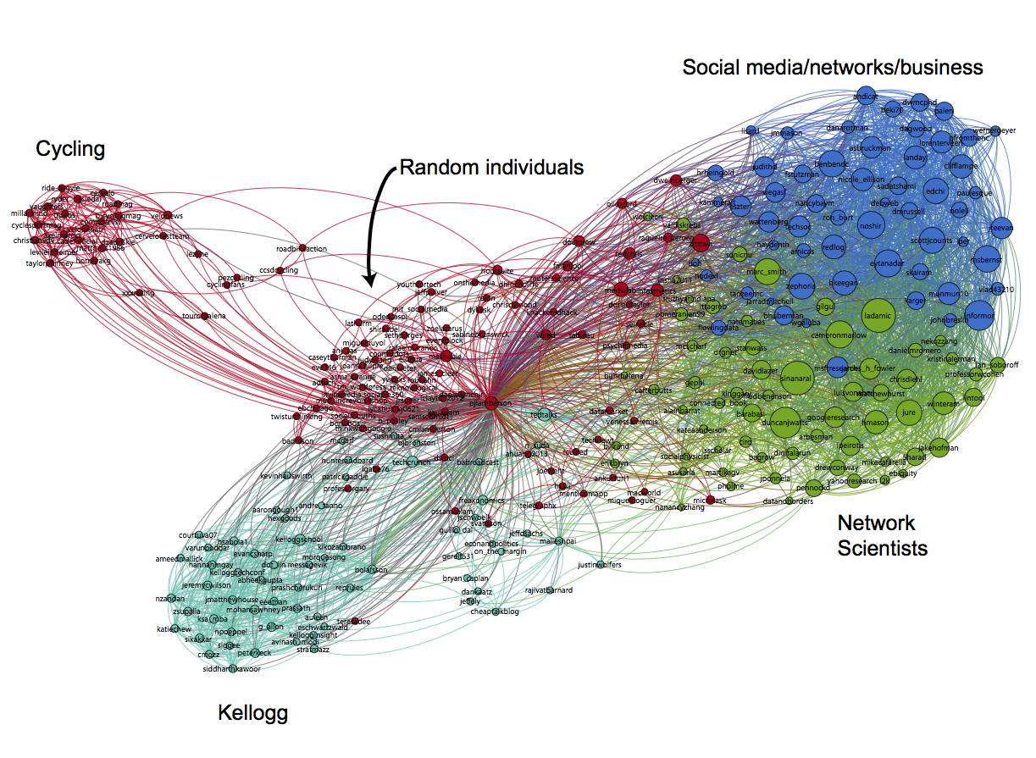
Contoh Teks Analisis
Wordcloud
Sentiment Analysis
Social Network Analysis

Slide 18
Cleaning & Preparing Data
Memahami Data
Dalam melakukan cleaning dan preparing, pahami tentang data terlebih dahulu. Misal mengetahui tentang skala datanya, serta tujuan data tersebut ada.

Slide 19
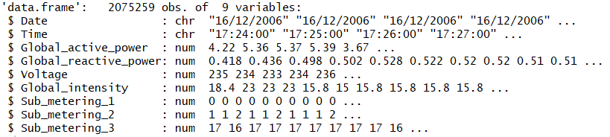
Melihat Struktur Data Frame Power
str(power)

Slide 20
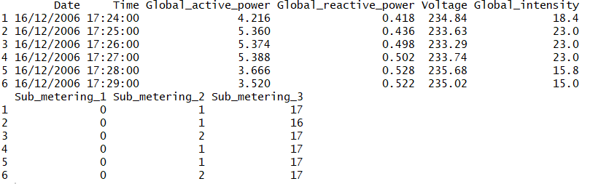
Menampilkan Beberapa Data Bagian Awal
head(power)

Slide 21
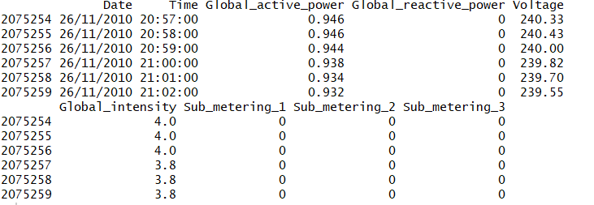
Menampilkan Beberapa Data Bagian Akhir
tail(power)

Slide 22
Deskripsi Data Power
Data pemakaian listrik rumah tangga selama 47 bulan, yang dikumpulkan oleh Electricite De France. Feature yang terdiri di data tersebut.
Date format dd/mm/yy
Time hh:mm:ss
Global_active_power, rata-rata pemakaian aktif (kilowatts)
Global_reactive_power, rata-rata pemakaian reactive (kilowatts)
Voltage, rata-rata perubahan voltage (volts)
Global_intensity, intesitas pemakaian listrik (ampere)
Sub_metering_1
Sub_metering_2
Sub_metering_3

Slide 23
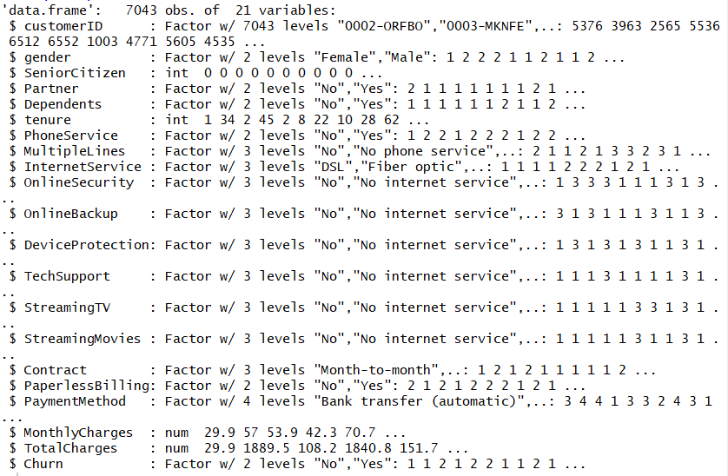
Melihat Struktur Data Frame Telco

Slide 24
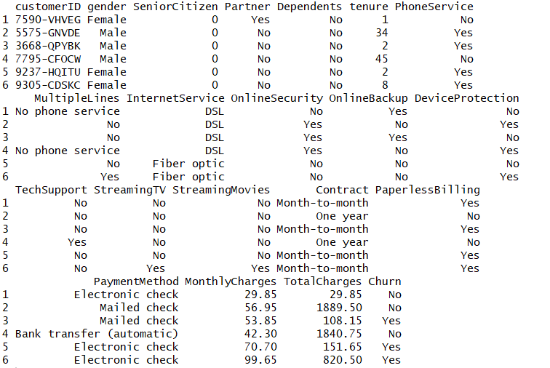
Menampilkan Beberapa Data Bagian Awal

Slide 25
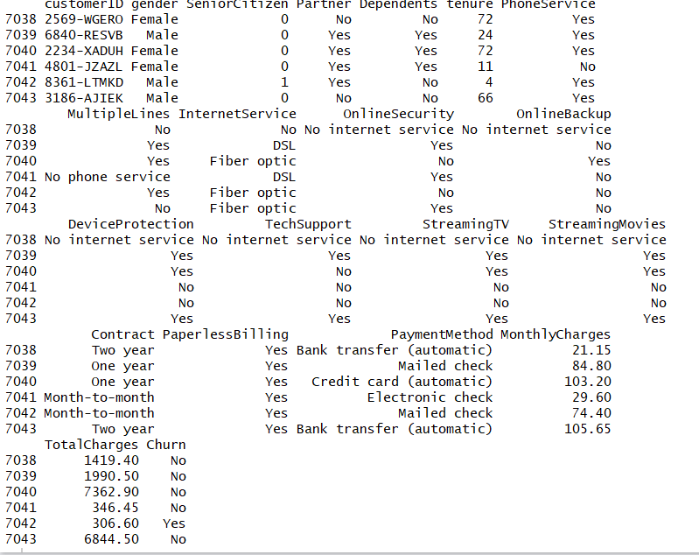
Menampilkan Beberapa Data Bagian Akhir

Slide 26
Deskripsi Data Telco
The data set includes information about:
Customers who left within the last month – the column is called Churn
Services that each customer has signed up for – phone, multiple lines, internet, online security, online backup, device protection, tech support, and streaming TV and movies
Customer account information – how long they’ve been a customer, contract, payment method, paperless billing, monthly charges, and total charges
Demographic info about customers – gender, age range, and if they have partners and dependents

Slide 27
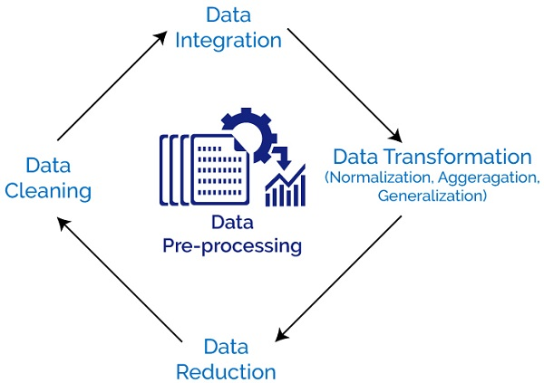
Cleaning & Preparing Data

Slide 28
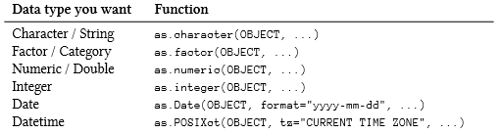
Periksa Type Data pada Data Frame

Slide 29
Data Power
Solusi Dirubah kedalam type data Date

Slide 30
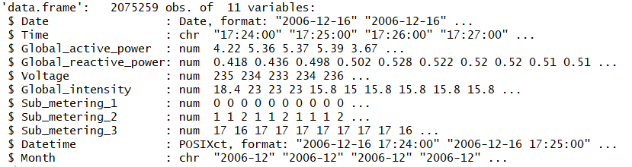
Data Power
#Merubah char ke Date
power$Date = as.Date(power$Date,format="%d/%m/%Y")
#Menambah kolom DateTime
power$Datetime = as.POSIXct(paste(power$Date, power$Time))
#Menambah kolom Month
power$Month = format(power$Date,"%Y-%m")
#Tampilkan Strukturnya
str(power)

Slide 31
Data Telco

Slide 32
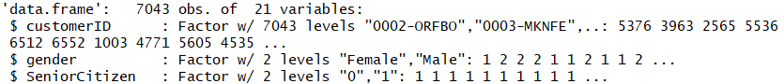
Data Telco
Seniorcitizen merupakan data kategorikal namun masih dianggap numeric, padahal nilai pada kolom tersebut adalah ‘0’ dan ‘1’, yang berarti 1 terdapat penduduk senior dan 0 tidak terdapat , sehingga perlu dirubah kedalam factor
#Solusi
telco$************* = as.factor(telco$*************)
#Tampilkan struktur data baru

Slide 33
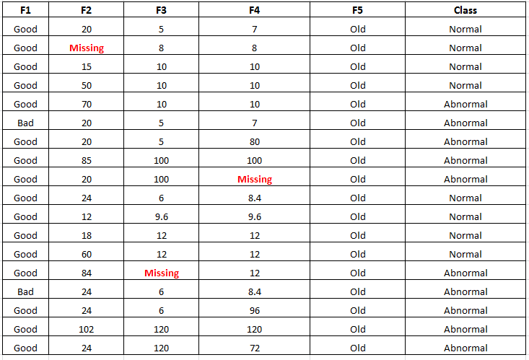
Missing Values
In statistics, missing data, or missing values, occur when no data value is stored for the variable in an observation. Missing data are a common occurrence and can have a significant effect on the conclusions that can be drawn from the data.

Slide 34
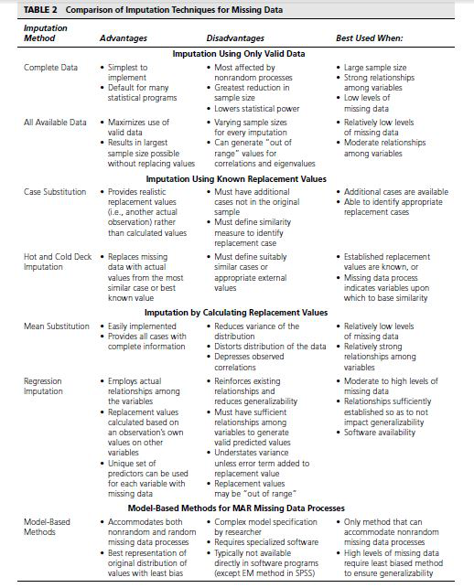

Slide 35
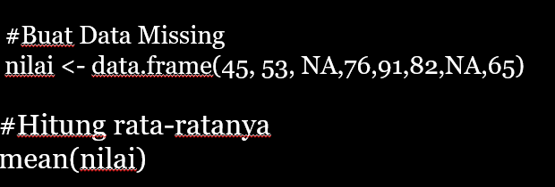
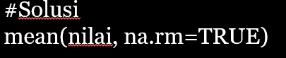
Missing Values

Slide 36
Imputasi Dengan Median
#Buat Data Missing
nilai <- c(45,53,NA,76,91,82,NA,65)
#Hitung rata-ratanya
mean(nilai)
#Solusi
mean(nilai,na.rm=TRUE)
#impute missing value
#Hitung nilai untuk imputasi misal median
me = median(nilai,na.rm = TRUE)
#Ganti NA dengan nilai tertentu
nilai[is.na(nilai)] = 999
nilai
#Ganti 999 dengan median
nilai[nilai==999]=me
mean(nilai)

Slide 37
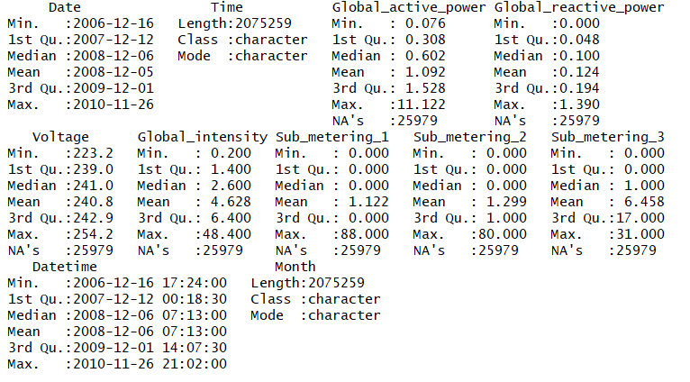
Missing Values Power
#Cara cepat untuk melihat apakah ada missing value di data tersebut
#Menggunakan summary, yang berarti melihat deskripsi keseluruhan data tersebut
summary(power)

Slide 38
Imputasi Missing Values Global_Active_Power
#Lihat Nilai Maxnya
max(power$Global_active_power,na.rm = T)
#Hitung Nilai Median
medianpower = median(power$Global_active_power,na.rm=T)
#Rubah Nilai NA kedalam nilai diatas Max bebas
power$Global_active_power[is.na(power$Global_active_power)] = 999
#Rubah Nilai bebas tadi menjadi nilai median
power$Global_active_power[power$Global_active_power==999] = medianpower

Slide 39
Imputasi Missing Values Global_reactive_Power
#Reactive Power
#Lihat Nilai Maxnya Global reactive power
max(power$Global_reactive_power,na.rm = T)
#Hitung Nilai Median
medianrepower = median(power$Global_reactive_power,na.rm=T)
#Rubah Nilai NA kedalam nilai diatas Max bebas
power$Global_reactive_power[is.na(power$Global_reactive_power)] = 999
#Rubah Nilai bebas tadi menjadi nilai median
power$Global_reactive_power[power$Global_reactive_power==999] = medianrepower

Slide 40
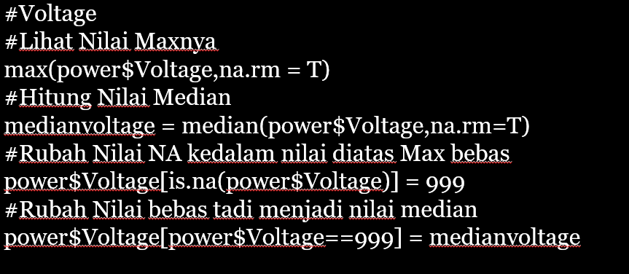
Imputasi Missing Values Global_voltage

Slide 41
Imputasi Missing Values Global_Intensity
#Intensity
#Lihat Nilai Maxnya
***(power$*************,na.rm = T)
#Hitung Nilai Median
medianintensity = ******(power$Global_intensity,na.rm=T)
#Rubah Nilai NA kedalam nilai diatas Max bebas
power$Global_intensity[is.na(power$Global_intensity)] = 999
#Rubah Nilai bebas tadi menjadi nilai median
power$Global_intensity[power$Global_intensity==999] = medianintensity

Slide 42
Imputasi Missing Values Sub_metering_1
#Sub_Metering_1
#Lihat Nilai Maxnya
max(power$Sub_metering_1,na.rm = T)
#Hitung Nilai Mode
modemetering1 = mode(power$Sub_metering_1)
#Rubah Nilai NA kedalam nilai diatas Max bebas
power$Sub_metering_1[is.na(power$Sub_metering_1)] = 999
#Rubah Nilai bebas tadi menjadi nilai median
power$Sub_metering_1[power$Sub_metering_1==999] = modemetering1

Slide 43
Imputasi Missing Values Sub_metering_2
#Sub_Metering_2
#Lihat Nilai Maxnya
max(power$Sub_metering_2,na.rm = T)
#Hitung Nilai Mode
modemetering2 = mode(power$Sub_metering_2)
#Rubah Nilai NA kedalam nilai diatas Max bebas
power$Sub_metering_2[is.na(power$Sub_metering_2)] = 999
#Rubah Nilai bebas tadi menjadi nilai median
power$Sub_metering_2[power$Sub_metering_2==999] = modemetering2

Slide 44
Imputasi Missing Values Sub_metering_3
#Sub_Metering_3
#Lihat Nilai Maxnya
max(power$Sub_metering_3,na.rm = T)
#Hitung Nilai Mode
modemetering3 = mode(power$Sub_metering_3)
#Rubah Nilai NA kedalam nilai diatas Max bebas
power$Sub_metering_3[is.na(power$Sub_metering_3)] = 999
#Rubah Nilai bebas tadi menjadi nilai mode
power$Sub_metering_3[power$Sub_metering_3==999] = modemetering3

Slide 45
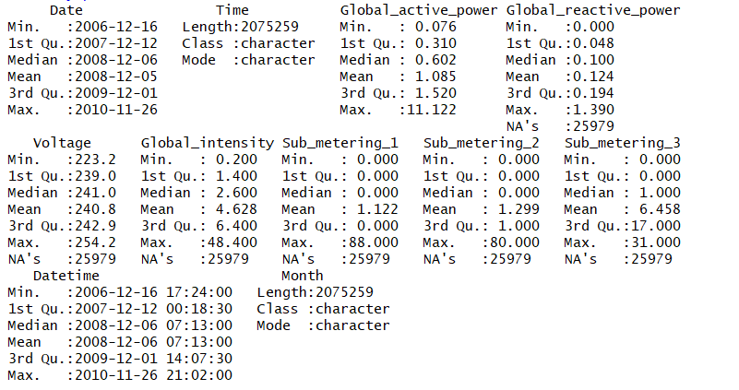
Imputasi Missing Values Power
#cek kembali dengan summary
summary(power)

Slide 46
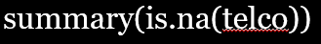
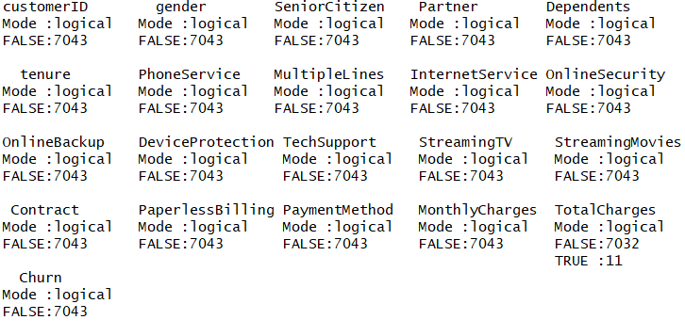
Missing Values Telco

Slide 47
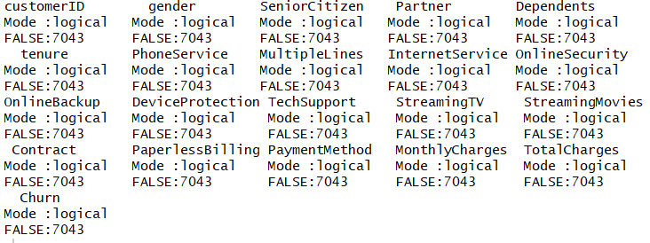
Impute Missing Values Telco
#Lihat Nilai Maxnya
max(*****$TotalCharges,na.rm = TRUE)
#Hitung Nilai Median
mediantelco = median(telco$************,na.rm=TRUE)
#Rubah Nilai NA kedalam nilai diatas Max bebas
telco$************ [is.na(*****$TotalCharges)] = 99999
#Rubah Nilai bebas tadi menjadi nilai median
telco$TotalCharges[telco$TotalCharges == 99999] = mediantelco
#cek kembali
summary(is.na(telco))

Slide 48
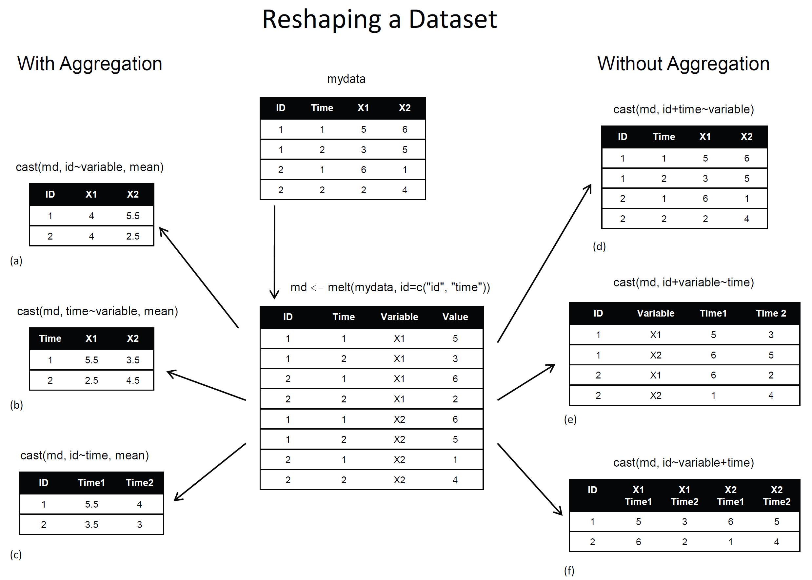
Data Reshaping
Merubah bentuk data untuk mempermudah analisa, seperti melakukan aggregate, membentuk rata-rata, melakukan transpose dan sejenisnya

Slide 49
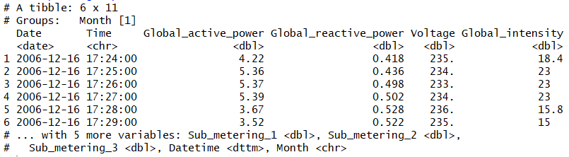
Reshaping Data Telco
#Membentuk grup berdasarkan Bulan
power_group = group_by(power,Month)
#tampilkan head data
head(power_group)

Slide 50
Data Reshaping Power
#Membentuk grup berdasarkan Bulan
power_group = group_by(power,Month)
#Membentuk data perbulan berisi maksimum pemakaian dan total pemakaian
power_monthly = summarize((power_group),Max_Demand_kW = max(Global_active_power),
Total_use_kWh = sum(Global_active_power)/60)
#menghapus partial month dari data frame
power_monthly = power_monthly[2:47,]
#mengkonversi month ke data
power_monthly$Month = as.Date(paste0(power_monthly$Month,"-01"))

Slide 51
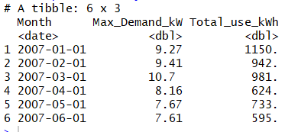
Data Reshaping Power
#cek data yang sudah direshape
head(power_monthly)

Slide 52
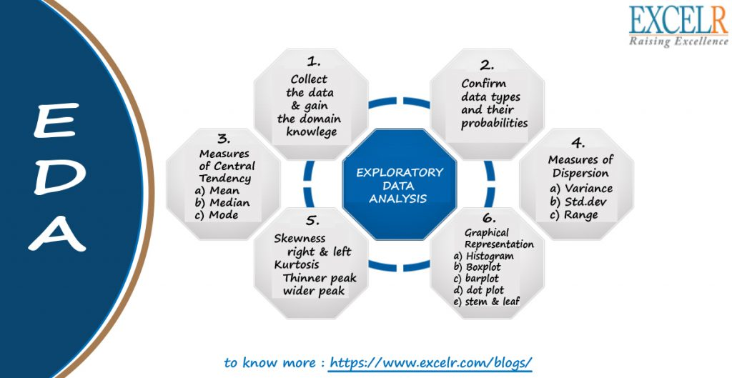
Data Visualization

Slide 53
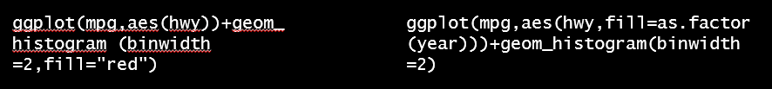
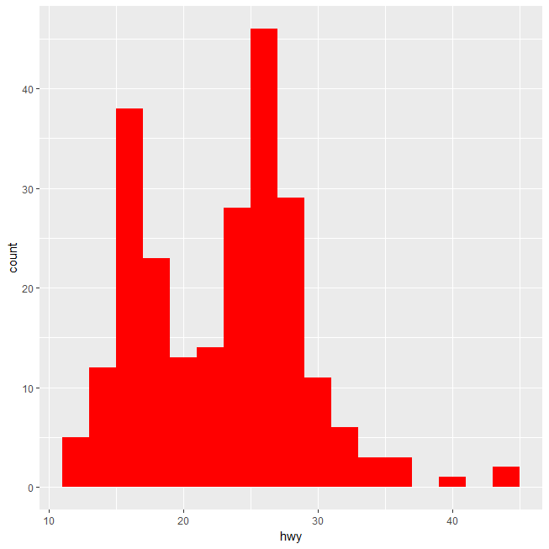
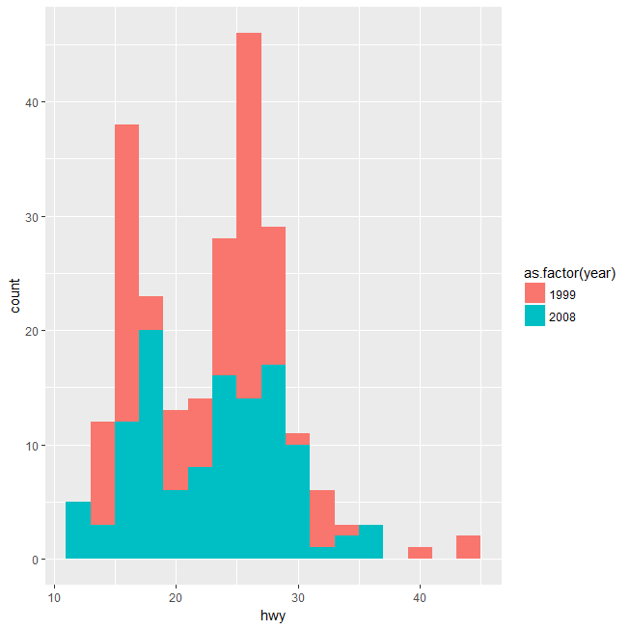
Histogram

Slide 54
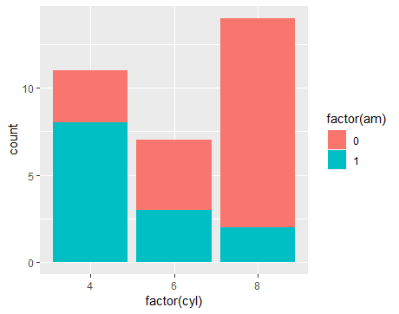
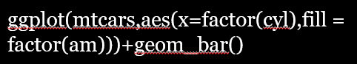
Barplot

Slide 55
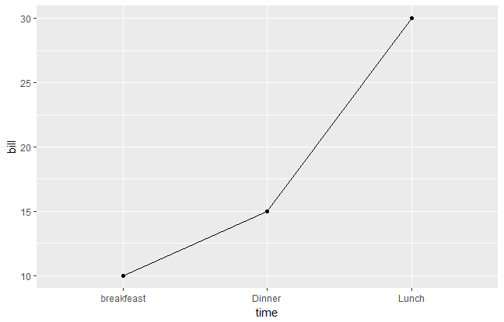
Line Plots
df = data.frame(time=c("breakfeast", "Lunch", "Dinner"),
bill=c(10, 30, 15))
ggplot(data=df, aes(x=time, y=bill, group=1)) + geom_line()+ geom_point()

Slide 56
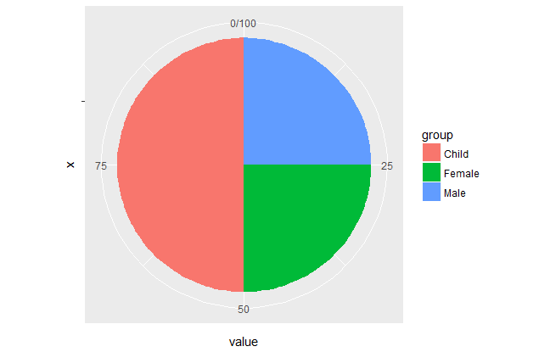
Pie Chart
#pie chart dengan data sendiri
df = data.frame(group = c("Male", "Female", "Child"),value = c(25, 25, 50))
#Buat barplot definisikan sebagai misal bp
bp = ggplot(df, aes(x="", y=value, fill=group))+ geom_bar(width = 1, stat = "identity")
#buat piechartnya
bp + coord_polar("y", start=0)

Slide 57
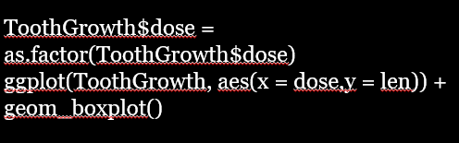
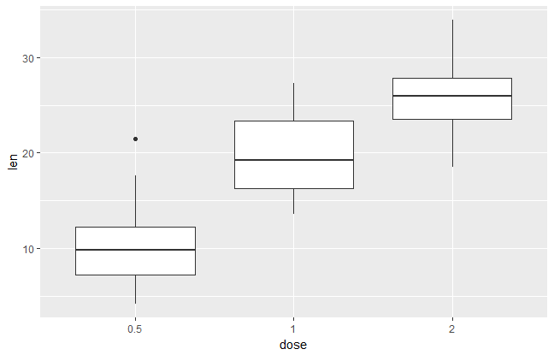
Box Plots

Slide 58
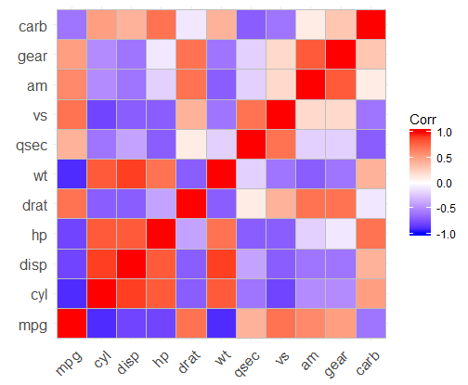
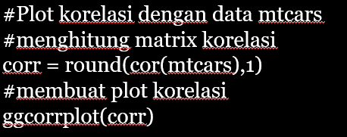
Plot Korelasi

Slide 59
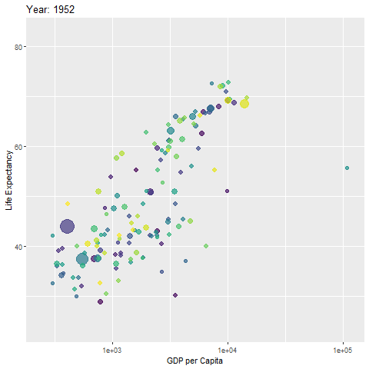
Plot Bergerak

Slide 60
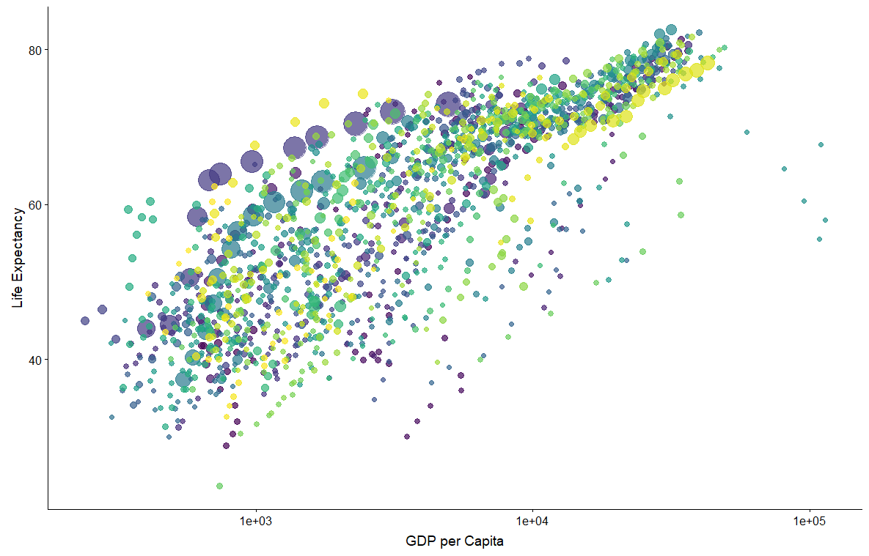
Plot Bergerak
#Pertama buat plot biasa definisikan misal p
p <- ggplot(gapminder,
aes(x=gdpPercap,y=lifeExp,size=pop,colour=country)) +
geom_point(show.legend=F,alpha=0.7)+
scale_color_viridis_d()+
scale_size(range=c(2,12)) +
scale_x_log10()+
labs(x="GDP per Capita",y="Life Expectancy")
#Tampilkan P
p

Slide 61
Plot Bergerak
#Buat p bergerak
p + transition_time(year) +
labs(title="Year: {frame_time}")

Slide 62
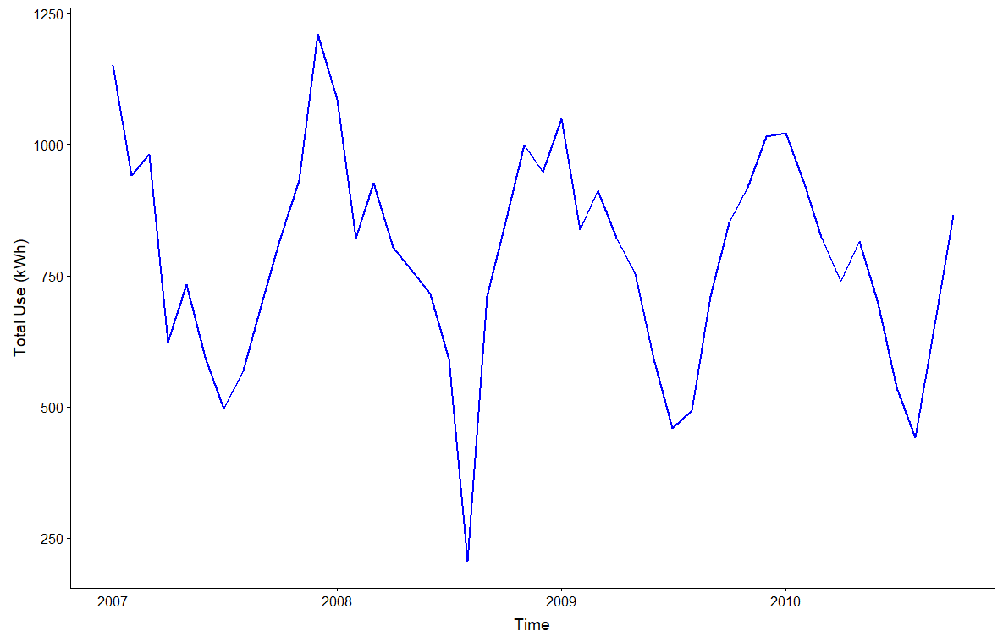
Data Visualisasi Untuk Power
#Time Series Plot Total Use kWh

Slide 63
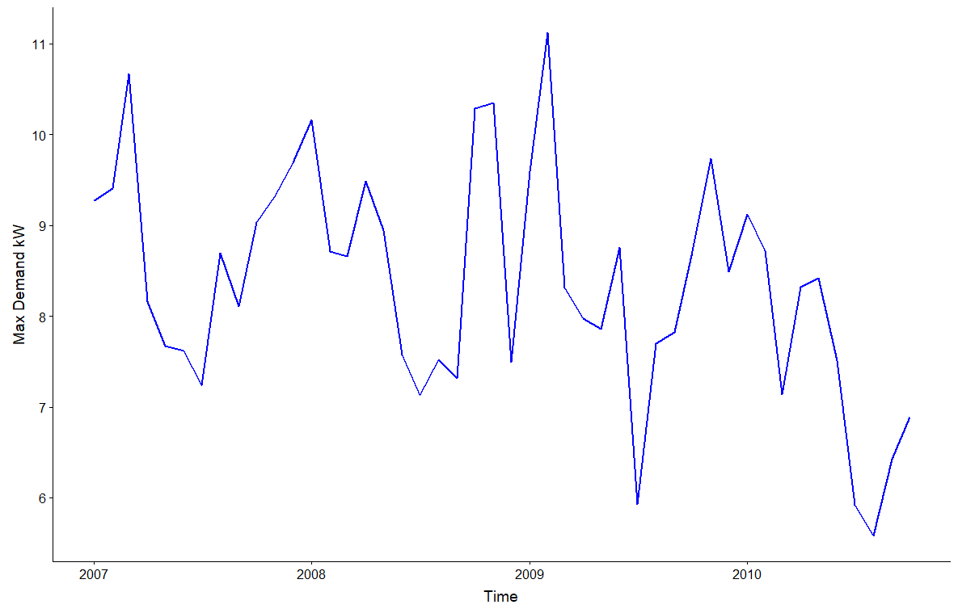
Data Visualisasi Untuk Power
#Time Series Plot Max Demand
ggplot(power_monthly,aes(Month, **********)) +
geom_line(col="blue",lwd=1) + labs(y="Max Demand kW",x="Time")

Slide 64
Kesimpulan Berdasarkan Visualisasi Power
Data pemakaian listrik penduduk perancis selama tahun 2007 hingga 2010 mempunyai pola musiman, pola musiman yang terbentuk adalah selalu rendah di pertengahan tahun dan selalu tinggi di awal tahun. Hal tersebut mungkin desebabkan adanya intervensi libur musim panas sehingga menyebabkan penduduk meninggalkan rumah dan mengurangi pemakaian listrik. Sedangkan tinggi diawal tahun intervensi karena natal dan tahun baru.
Maksimal Pemakaian listrik sedikit fluktuatif, namun selalu tinggi diakhir hingga awal tahun. Dugaan awal adalah karena intervensi dari perayaan natal dan tahun baru.

Slide 65
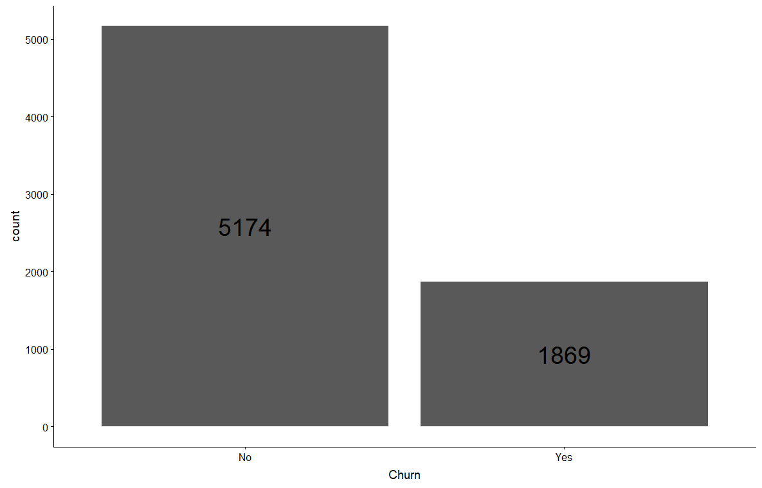
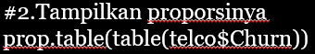
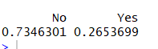
Data Visualisasi Untuk Telco

Slide 66


Data Visualisasi Untuk Telco

Slide 67

Data Visualisasi Untuk Telco
#4.Hubungan Churn Rate dengan Senior Citizen
ggplot(telco,aes(x=*************,fill=Churn)) + ****_***() +
geom_text(aes(label=..count..),stat='count',position=position_stack(0.5),size=5)+
labs(y="Customer Count",title="Churn Rate by Senior Citizen",size=5)

Slide 68

Data Visualisasi Telco
#5.Tulis Code Untuk Menampilkan Hubungan Churn Rate dengan Partner

Slide 69
Data Visualisasi Telco
#6.Multiplot
#definisikan theme1 untuk merapikan label plot nanti
theme1 = theme_bw()+
theme(axis.text.x = element_text(angle = 0, hjust = 1, vjust = 0.5),legend.position="none")
#atur grid
options(repr.plot.width = 12, repr.plot.height = 8)
#bentuk plot
plot_grid(ggplot(telco, aes(x=Dependents,fill=Churn))+ geom_bar()+theme1,
ggplot(telco, aes(x=PhoneService,fill=Churn))+ geom_bar(position = 'fill')+theme1,
ggplot(telco, aes(x=MultipleLines,fill=Churn))+ geom_bar(position = 'fill')+theme1,
ggplot(telco, aes(x=InternetService,fill=Churn))+ geom_bar(position = 'fill')+theme1,
ggplot(telco, aes(x=OnlineSecurity,fill=Churn))+ geom_bar(position = 'fill')+theme1,
ggplot(telco, aes(x=OnlineBackup,fill=Churn))+ geom_bar(position = 'fill')+theme_bw()+
scale_x_discrete(labels = function(x) str_wrap(x, width = 10)),align = "h")

Slide 70


Slide 71

Data Visualisasi Telco

Slide 72


Slide 73

Data Visualisasi Telco
#8.Hubungan Churn Rate Dengan Tenure
ggplot(telco, aes(y= tenure, x = "", fill = Churn)) + geom_boxplot()+ theme_bw()+ xlab(" ")

Slide 74


Data Visualisasi Telco

Slide 75

Data Visualisasi Telco
#10.Tulis Kode untuk menampilkan hubungan churn rate dengan monthly charge

Slide 76
Kesimpulan Berdasarkan Visualisasi Telco
Data tidak balance, pelanggan yang tidak churn rate lebih banyak dibandingkan pelanggan yang churn rate
Tidak memiliki senior citizen cenderung tidak churn rate.
Pelanggan yang tidak memiliki kebergantungan mempunyai kecenderungan untuk churn rate yang lebih tinggi.
Contract month-to-month memiliki kecenderungan lebih tinggi.
Median pelanggan untuk churn rate adalah 10 bulan.
Total tagihan yang tinggi atau mahal membuat pelanggan untuk churn rate

Slide 77


Machine Learning
Analytics
Umumnya mesin learning dibagi kedalam 4 bagian, yakni supervised learning, unsupervised learning, reinforcement learning, dan asosiasi rule.
Regresi adalah metode yang digunakan untuk memprediksi berdasarkan data yang telah ada. Hal tersebut membuat regresi mempunyai syarat bahwa variabel Y nya bertipe kontinu.
Sedangkan klasifikasi adalah melakukan prediksi berupa kategorikal data berdasarkan data yang telah ada.
Regresi
Klasifikasi

Slide 78





Data Structure
Observations | $$Y$$ | $$X_{1}$$ | $$X_{2}$$ | . | . | . | $$X_{k}$$
1 | $$Y_{1}$$ | $$X_{11}$$ | $$X_{12}$$ | . | . | . | $$X_{1k}$$
2 | $$Y_{2}$$ | $$X_{21}$$ | $$X_{22}$$ | . | . | . | $$X_{2k}$$
. | . | . | . | . | . | . | .
. | . | . | . | . | . | . | .
. | . | . | . | . | . | . | .
n | $$Y_{n}$$ | $$X_{n1}$$ | $$X_{n2}$$ | . | . | . | $$X_{nk}$$
Classificatin Case
Regression Case
$Y$: Nominal / Ordinal
$Y$: Interval / Rasio
$X$: Nominal / Ordinal / Interval / Rasio
$X$: Nominal / Ordinal / Interval / Rasio

Slide 79

The Logistic Model
In any regression problem, the key quantity is the mean value of outcome variable, given values of some predictor variables. It can be called “conditional mean”.
In linear regression, This conditional mean can be expressed by
$$E\left(Y|x\right)=β_{0}+β^{T}x$$
It is possible to take any values of $x$ in range $\left(−∞,∞\right)$

Slide 80

The Logistic Model
$$y=\left\{\begin{matrix}0 \\ 1\end{matrix}\right.\begin{matrix} \text{if} \text{not} \text{default} \\ \text{if} \text{default}\end{matrix} \\ x= \text{balance}$$
In binary response variable we can take :
$$E\left(Y|x\right)=p\left(x\right)=P(Y=1|x)$$
And if we apply the linear regression model, we get :
$$p\left(x\right)=β_{0}+βx$$

Slide 81

The Logistic Model
For very large (or small) balance, we will get values bigger than 1 (or smaller than 0)
Picture from: Intoduction to Statistical Learning

Slide 82


Slide 83


The Logistic Model
Logistic function gives the output of $p\left(X\right)$ between 0 and 1 :
$$p\left(X\right)=\frac{e^{β_{0}+βx}}{1+e^{β_{0}+βx}}$$
or equivalent with
$$\frac{p\left(X\right)}{1−p\left(X\right)}=e^{β_{0}+βx} \\ \log\left(\frac{p\left(X\right)}{1−p\left(X\right)}\right)=β_{0}+βxx$$
Picture from: Intoduction to Statistical Learning

Slide 84
The Logistic Model
Logistic function gives the output of $p\left(X\right)$ between 0 and 1 :
$$p\left(X\right)=\frac{e^{β_{0}+βx}}{1+e^{β_{0}+βx}}$$
or equivalent with
$$\frac{p\left(X\right)}{1−p\left(X\right)}=e^{β_{0}+βx} \\ \log\left(\frac{p\left(X\right)}{1−p\left(X\right)}\right)=β_{0}+βxx$$
Picture from: Intoduction to Statistical Learning
log(odds) or logit

Slide 85

Multiple Logistic Regression
Consider the log-odds function:
$$\log\left(\frac{p\left(X\right)}{1−p\left(X\right)}\right)=β_{0}+βx$$
If there are more than 1 variables, we can formulate the function:
$$\log\left(\frac{p\left(X\right)}{1−p\left(X\right)}\right)=β_{0}+β_{1}x_{1}+β_{2}x_{2}+…+β_{p}x_{p}$$
Or equivalent with
$$\log\left(\frac{p\left(X\right)}{1−p\left(X\right)}\right)=\sum_{i=0}^{p}{β_{i}x_{i}}$$
where $x_{0}=1$

Slide 86

Estimating Parameter
Maksimum Likelihood Estimation:
Since $y$ is binary, $y\sim Bernouli\left(θ\right),$ i.e
$$p\left(y|θ\right)={θ^{y}\left(1−θ\right)}^{1−y}, \text{for} y=\left\{0,1\right\} \text{and} 0≤θ≤1$$
The likelihood function:
$$L\left(θ|y\right)=\prod_{i=1}^{N}{p\left(y_{i}|θ_{i}\right)}=\prod_{i=1}^{N}{{{θ_{i}}^{y_{i}}\left(1−θ_{i}\right)}^{1−y_{i}}}$$

Slide 87

Estimating Parameter
The log-likelihood function:
$$\log{L\left(θ|y\right)}=𝓁\left(θ\right)=\sum_{i=1}^{N}{y_{i}\log{θ_{i}}+}\left(1−y_{i}\right)\log\left(1−θ_{i}\right)$$

Slide 88

Estimating Parameter
Remember that
$$β_{0}+β_{1}x_{1}+β_{2}x_{2}+…+β_{p}x_{p}=\sum_{i=0}^{p}{β_{i}x_{i}}, \\ \text{where} x_{0}=1$$
and
$$θ_{i}=P(y_{i}=1|x_{i},β)=p\left(x_{i}\right)=\frac{exp\left(\sum_{j=0}^{p}{β_{j}x_{ij}}\right)}{1+exp\left(\sum_{j=0}^{p}{β_{j}x_{ij}}\right)}$$

Slide 89

Estimating Parameter
The log-likelihood function can be formulated by :
$$𝓁\left(β\right)=\sum_{i=1}^{N}{\left(y_{i}\log{p\left(x_{i}\right)}+\left(1−y_{i}\right)\log\left(1−p\left(x_{i}\right)\right)\right)} \\ =\sum_{i=1}^{N}{\left(y_{i}\log\left(\frac{p\left(x_{i}\right)}{\left.1−p\left(x_{i}\right)\right.}\right)−\log\left(\frac{1}{\left.1−p\left(x_{i}\right)\right.}\right)\right) } \\ =\sum_{i=1}^{N}{\left(y_{i}\left(\sum_{j=0}^{p}{β_{j}x_{ij}}\right)−\log\left(1+\exp\left(\sum_{j=0}^{p}{β_{j}x_{ij}}\right)\right)\right)}$$

Slide 90

Estimating Parameter
$$𝓁\left(β\right)=\sum_{i=1}^{N}{\left(y_{i}\left(\sum_{j=0}^{p}{β_{j}x_{ij}}\right)−\log\left(1+\exp\left(\sum_{j=0}^{p}{β_{j}x_{ij}}\right)\right)\right)}$$

Slide 91
Estimating Parameter
$$𝓁\left(β\right)=\sum_{i=1}^{N}{\left(y_{i}\left(\sum_{j=0}^{p}{β_{j}x_{ij}}\right)−\log\left(1+\exp\left(\sum_{j=0}^{p}{β_{j}x_{ij}}\right)\right)\right)}$$
Bad News
There’s no closed-form can solve this maximization problem

Slide 92


Stochastic Gradient Descent
Stochastic Gradient Descent → Minimization Problem
We want to maximize the likelihood function
$$\text{Negative} \text{Log}\text{−}\text{Likelihood}=−𝓁\left(β\right)=\sum_{i=1}^{N}{\left(\log\left(1+\exp\left(\sum_{j=0}^{p}{β_{j}x_{ij}}\right)\right)+y_{i}\left(\sum_{j=0}^{p}{β_{j}x_{ij}}\right)\right)}$$

Slide 93


Stochastic Gradient Descent
Initialize a learning rate and random small parameter value of $β$
Update Rule:
$$β^{(t+1)}←β^{(t)}−∆β$$
$$∆β=η∇_{β}\left(−𝓁\left(β\right)\right) \\ =−η∇_{β}𝓁\left(β\right)$$
Gradient:
$$∇_{β}𝓁\left(β\right)={\left[\frac{∂𝓁\left(β\right)}{∂β_{0}},\frac{∂𝓁\left(β\right)}{∂β_{1}},…,\frac{∂𝓁\left(β\right)}{∂β_{p}}\right]}^{T}$$

Slide 94
Stochastic Gradient Descent
Initialize a learning rate and random small parameter value of $β$
Update Rule:
$$β^{(t+1)}←β^{(t)}−∆β$$
$$∆β=η∇_{β}\left(−𝓁\left(β\right)\right) \\ =−η∇_{β}𝓁\left(β\right)$$
Gradient:
$$∇_{β}𝓁\left(β\right)={\left[\frac{∂𝓁\left(β\right)}{∂β_{0}},\frac{∂𝓁\left(β\right)}{∂β_{1}},…,\frac{∂𝓁\left(β\right)}{∂β_{p}}\right]}^{T}$$
Learning Rate

Slide 95


Stochastic Gradient Descent

Slide 96

Stochastic Gradient Descent
$$\frac{∂𝓁\left(β\right)}{∂β_{0}}=\frac{∂\left(\sum_{i=1}^{N}{\left(y_{i}\left(\sum_{j=0}^{p}{β_{i}x_{ij}}\right)−\log\left(1+\exp\left(\sum_{j=0}^{p}{β_{i}x_{ij}}\right)\right)\right)}\right)}{∂β_{0}} \\ =\sum_{i=1}^{N}{\left(y_{i}−\frac{\exp\left(\sum_{j=0}^{p}{β_{i}x_{ij}}\right)}{1+\exp\left(\sum_{j=0}^{p}{β_{i}x_{ij}}\right)}\right)} \\ =\sum_{i=1}^{N}{\left(y_{i}−P\left(y_{i}=1|x_{i},β\right)\right)}$$

Slide 97

Stochastic Gradient Descent
$$\frac{∂𝓁\left(β\right)}{∂β_{1}}=\sum_{i=1}^{N}{x_{i1}\left(y_{i}−P(y_{i}=1|x_{i},β)\right)}$$
$$\frac{∂𝓁\left(β\right)}{∂β_{2}}=\sum_{i=1}^{N}{x_{i2}\left(y_{i}−P(y_{i}=1|x_{i},β)\right)}$$
$$⋮$$
$$\frac{∂𝓁\left(β\right)}{∂β_{p}}=\sum_{i=1}^{N}{x_{ip}\left(y_{i}−P(y_{i}=1|x_{i},β)\right)}$$

Slide 98

Stochastic Gradient Descent
Update Rule:
$$\left(\begin{matrix}\begin{matrix}{β_{0}}^{(t+1)} \\ {β_{1}}^{(t+1)}\end{matrix} \\ \begin{matrix}⋮ \\ {β_{p}}^{(t+1)}\end{matrix}\end{matrix}\right)←\left(\begin{matrix}\begin{matrix}{β_{0}}^{(t)} \\ {β_{1}}^{(t)}\end{matrix} \\ \begin{matrix}⋮ \\ {β_{p}}^{(t+}\end{matrix}\end{matrix}\right)+η\left(\begin{matrix}\begin{matrix}\sum_{i=1}^{N}{\left(y_{i}−P(y_{i}=1|x_{i},{β }^{(t)})\right)} \\ \sum_{i=1}^{N}{x_{i1}\left(y_{i}−P(y_{i}=1|x_{i},{β }^{(t)})\right)}\end{matrix} \\ \begin{matrix}⋮ \\ \sum_{i=1}^{N}{x_{ip}\left(y_{i}−P(y_{i}=1|x_{i},{β }^{(t)})\right)}\end{matrix}\end{matrix}\right)$$

Slide 99

Stochastic Gradient Descent
For each observation $x_{i}$: Update $β$
$$\left(\begin{matrix}\begin{matrix}{β_{0}}^{(t+1)} \\ {β_{1}}^{(t+1)}\end{matrix} \\ \begin{matrix}⋮ \\ {β_{p}}^{(t+1)}\end{matrix}\end{matrix}\right)←\left(\begin{matrix}\begin{matrix}{β_{0}}^{(t)} \\ {β_{1}}^{(t)}\end{matrix} \\ \begin{matrix}⋮ \\ {β_{p}}^{(t)}\end{matrix}\end{matrix}\right)+η\left(\begin{matrix}\begin{matrix}\left(y_{i}−P\left(y_{i}=1|x_{i},{β }^{(t)}\right)\right) \\ x_{i1}\left(y_{i}−P\left(y_{i}=1|x_{i},{β }^{(t)}\right)\right)\end{matrix} \\ \begin{matrix}⋮ \\ x_{ip}\left(y_{i}−P\left(y_{i}=1|x_{i},{β }^{(t)}\right)\right)\end{matrix}\end{matrix}\right)$$
Do until converge: $β^{(t+1)}−β^{\left(t\right)}≈0$ or → epoch

Slide 100

SGD Algorithm
Initialize learning rate and random values of parameter $β$
For each observation do:
$$\left(\begin{matrix}\begin{matrix}{β_{0}}^{(t+1)} \\ {β_{1}}^{(t+1)}\end{matrix} \\ \begin{matrix}⋮ \\ {β_{p}}^{(t+1)}\end{matrix}\end{matrix}\right)←\left(\begin{matrix}\begin{matrix}{β_{0}}^{(t)} \\ {β_{1}}^{(t)}\end{matrix} \\ \begin{matrix}⋮ \\ {β_{p}}^{(t)}\end{matrix}\end{matrix}\right)+η\left(\begin{matrix}\begin{matrix}\left(y_{i}−P\left(y_{i}=1|x_{i},{β }^{(t)}\right)\right) \\ x_{i1}\left(y_{i}−P\left(y_{i}=1|x_{i},{β }^{(t)}\right)\right)\end{matrix} \\ \begin{matrix}⋮ \\ x_{ip}\left(y_{i}−P\left(y_{i}=1|x_{i},{β }^{(t)}\right)\right)\end{matrix}\end{matrix}\right)$$
Keep updating beta until converge, or until defined epoch. Do until converge: $β^{(t+1)}−β^{\left(t\right)}≈0$ or → epoch

Slide 101

Evaluation
After we get the value of $β$, we can calculate:
$$p\left(x_{i}\right)=\frac{exp\left(\sum_{j=0}^{p}{β_{j}x_{ij}}\right)}{1+exp\left(\sum_{j=0}^{p}{β_{j}x_{ij}}\right)}$$
where $0<p\left(x_{i}\right)<1$
Our prediction can be calculated by: ${\hat{y}}_{i}=\left\{\begin{matrix}0, \\ 1,\end{matrix} \begin{matrix}p\left(x_{i}\right)<0.5 \\ p\left(x_{i}\right)>0.5\end{matrix}\right.$

Slide 102

Model Performance
In Sample Out Sample; Membagi data kedalam data testing dan training. Data training digunakan untuk membangun model kemudian data testing digunakan untuk mengevaluasi kebaikan model. Untuk regresi biasanya menggunakan RMSE sedangkan klasifikasi menggunakan akurasi prediksi.

Slide 103

Cross Validation
Membagi data kedalam beberapa bagian (secara umum >2) secara proporsional, kemudian menggunakan masing-masing bagian sebagai data training dan testing dan dilakukan sebanyak jumlah bagian tersebut.

Slide 104


Slide 105
Machine Learning Secara Singkat
Mengevaluasi Model, Jika Baik Gunakan/Simpulkan, Jika Kurang Baik Ulangi Membangun Model dengan Merubah parameter atau mengeksplor data lagi
Membagi Data Ke Dalam Training dan Testing
Membangun Model Berdasarkan hasil cleaning dan preparing

Slide 106
Hipotesis Testing
H₀ : B_{i} = 0 (Variabel Prediktor Tidak Berpengaruh Signifikan Terhadap Respon
H₁ : B_{i} ≠ 0 (Variabel Prediktor Berpengaruh Signifikan Terhadap Respon)
Taraf Signifikan : Tentukan α, missal 5% = 0.05
Statistik Uji : p-value
Daerah Kritis : Tolak H₀ jika p-value kurang dari 0.05

Slide 107

Analytics power Metode Forecast

Slide 108


Slide 109

Plot Hasil Forecast Power
#Menampilkan plot
plot(total_use_fc)

Slide 110

Analytic Telco Logistik Regression

Slide 111



Slide 112
MODEL BELUM CUKUP BAIK,
NEXT STEP

Slide 113
Cleaning the Categorical features
Standardising Continuous features
Creating derived features
Creating dummy variables for factor variables
Handling Imbalanced
Creating the final dataset
Splitting the data into train and validation set.
Model evaluation

Slide 114

Cleaning the Categorical features
Mengoptimalkan variabel kategori, seperti pada bagian online security, kelas No internet service dan No terpisah, Padahal keduanya memiliki arti yang sama.

Slide 115


Cleaning Categorical Feature

Slide 116
Standardising Continuous features
Mentransformasi Data (kontinu) kedalam skala yang sama. Pada kasus ini variabel yang akan distandarkan adalah tenure, monthly charge dan total charges.

Slide 117


Standardizing

Slide 118
Creating Derived Feature
Membuat derived feature adalah membuat feature baru berdasarkan feature yang ada. Pada kasus ini akan dibuat feature baru yang berasal dari feature tenure.

Slide 119
Creating derived features
#Membuat Feature Baru Berdasarkan Feature yang ada
telco = mutate(telco,tenure_bin = tenure)
telco$tenure_bin[telco$tenure_bin >=0 & telco$tenure_bin <= 12] <- '0-1 year'
telco$tenure_bin[telco$tenure_bin > 12 & telco$tenure_bin <= 24] <- '1-2 years'
telco$tenure_bin[telco$tenure_bin > 24 & telco$tenure_bin <= 36] <- '2-3 years'
telco$tenure_bin[telco$tenure_bin > 36 & telco$tenure_bin <= 48] <- '3-4 years'
telco$tenure_bin[telco$tenure_bin > 48 & telco$tenure_bin <= 60] <- '4-5 years'
telco$tenure_bin[telco$tenure_bin > 60 & telco$tenure_bin <= 73] <- '5-6 years'
telco$tenure_bin <- as.factor(telco$tenure_bin)
#Tampilkan Barchart Variabel Baru
ggplot(telco, aes(tenure_bin, fill = tenure_bin)) + geom_bar()+ theme_bw()

Slide 120


Slide 121
Creating dummy variables for factor variables
Membentuk variabel dummy hanya dilakukan pada kategorikal data saja. Tujuannya adalah mengatasi singularitas atau kombinasi linear.

Slide 122

Creating dummy variables for factor variables
#Membuat Dummy Variabel
#Buat data frame untuk variabel yang kategori
telco_cat <- telco[,-c(5,18,19)]
#Buat Variabel Dummynya
dummy<- data.frame(sapply(telco_cat,function(x) data.frame(model.matrix(~x-1,data =telco_cat))[,-1]))
#Tampilkan
View(dummy)

Slide 123


Memerging Data Final

Slide 124

Handling Imbalanced With Oversampling/Undersampling
Oversampling adalah membuat data baru berdasarkan data yang telah ada untuk menyamakan proporsi dengan data yang majoritas, sedangkan undersampling adalah sebaliknya.

Slide 125


Oversampling Undersampling

Slide 126

Splitting the data into train and validation set.

Slide 127
Model 1
#Buat Model 1
model1 <- glm(*****~.,train,family = binomial)
summary(model1)

Slide 128


Slide 129
Feature Selection
Masih Terdapat Variabel yang tidak signifikan, Selanjutnya dilakukan pemilihan feature. Pemilihan feature adalah memilih feature yang terbaik atau yang terpenting yang digunakan dalam model. Banyak sekali metode dalam pemilihan feature, pada kasus ini, kita menggunakan stepAIC atau stepwise yang dikoreksi menggunakan nilai AIC. Nilai AIC adalah nilai kebaikan model dimana feature didalam model tersebut berbeda dengan model yang akan dibandingkan.

Slide 130

Feature Selection
Churn ~ tenure + MonthlyCharges + TotalCharges + Partner + Dependents + PhoneService + MultipleLines + InternetService.xFiber.optic + InternetService.xNo + OnlineSecurity + OnlineBackup + DeviceProtection + TechSupport + StreamingTV + StreamingMovies + Contract.xOne.year + Contract.xTwo.year + PaperlessBilling + PaymentMethod.xElectronic.check + PaymentMethod.xMailed.check + tenure_bin.x2.3.years + tenure_bin.x3.4.years + tenure_bin.x4.5.years + tenure_bin.x5.6.years

Slide 131
Bentuk Model 2
#Model 2
model2 <- glm(Churn ~ tenure + MonthlyCharges + TotalCharges + Partner + Dependents +
PhoneService + MultipleLines + InternetService.xFiber.optic +
InternetService.xNo + OnlineSecurity + OnlineBackup + DeviceProtection +
TechSupport + StreamingTV + StreamingMovies + Contract.xOne.year +
Contract.xTwo.year + PaperlessBilling + PaymentMethod.xElectronic.check +
PaymentMethod.xMailed.check + tenure_bin.x2.3.years + tenure_bin.x3.4.years +
tenure_bin.x4.5.years + tenure_bin.x5.6.years,train,family=binomial)
summary(model2)

Slide 132


Slide 133
Bentuk Model 3
#Model 3
model3 <- glm(Churn ~ tenure + MonthlyCharges + TotalCharges + Partner + Dependents +
PhoneService + InternetService.xFiber.optic +
InternetService.xNo + OnlineSecurity + OnlineBackup + DeviceProtection +
TechSupport + StreamingTV + StreamingMovies + Contract.xOne.year +
Contract.xTwo.year + PaperlessBilling + PaymentMethod.xElectronic.check +
PaymentMethod.xMailed.check + tenure_bin.x2.3.years + tenure_bin.x3.4.years +
tenure_bin.x4.5.years + tenure_bin.x5.6.years,train,family='binomial')
summary(model3)

Slide 134


Slide 135
Model 3 sudah baik, sekarang lakukan perhitungan akurasi

Slide 136

Hitung Ketepatan Akurasi Dengan Model final /Model 3
#Model Final
final_model = model3
#Hitung Prediksi atau Yhat
pred = predict(final_model,type='response',newdata = test[,-24])
#buat feature pred pada data test
test$prob = pred
#Lakukan prediksi berdasarkan cutoff 0.5
pred_churn = factor(ifelse(pred>=0.50,"Yes","No"))
#Buat data actual churn
actual_churn = factor(ifelse(test$Churn==1,"Yes","No"))
#buat table akurasi/confusion matrix
t = table(pred_churn,actual_churn)
#tampilkan table
t

Slide 137


Confusion Matrix

